Slide 1


Slide 2
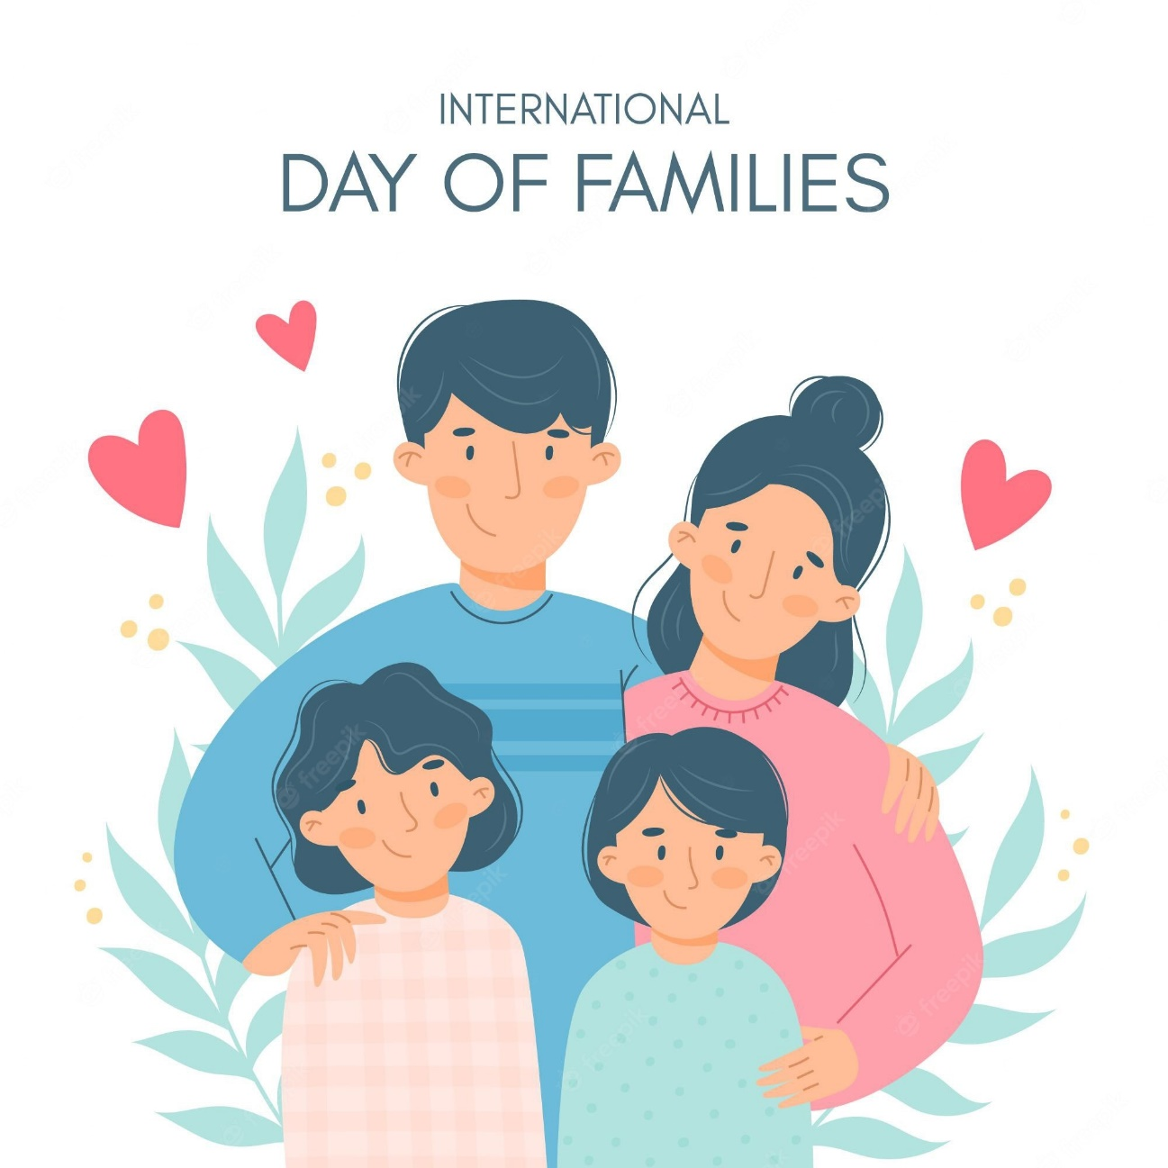
Family Day in Viet Nam and other countries in the world
Member: Dong Xuan Vu
Nguyen Quoc Phuong
Hoang Minh Duc
Nguyen Duc Quang

Slide 3
Family Day
 | In Viet Nam | In Canada
Where is it celebrated?
When is it celebrated?
When it was first celebrated?
Why is it celebrated?
- Whole the country
- In the Canadian provinces of Alberta, British Columbia, Ontario, Saskatchewan and Brunswick
- On June 28th
- On the 3rd Monday of February
- On June 28th, 2001
- In 1990
- To emphasize the importance of family
- To strengthen ties and bring relatives together to celebrate the importance of family

Slide 4

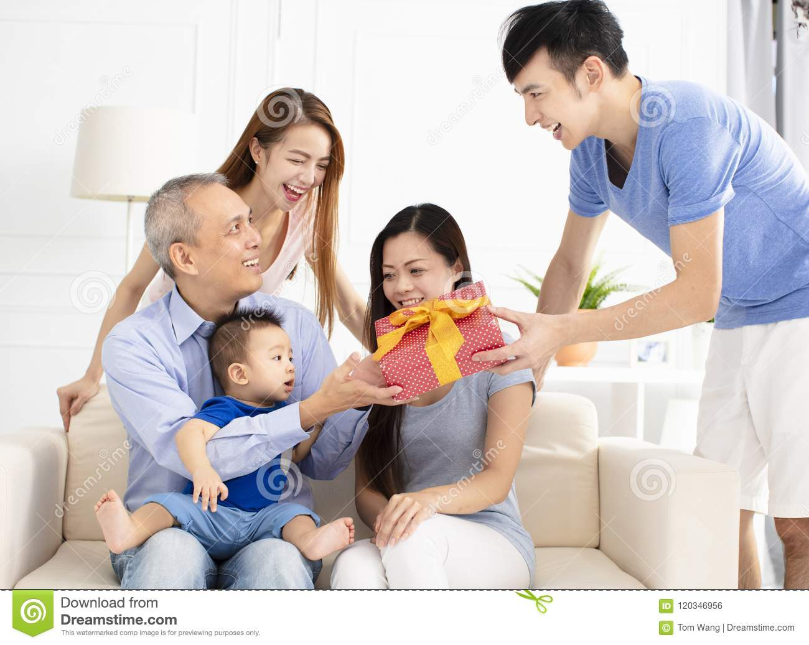
What people often do to celebrate Family Day in Viet Nam?
Do housework
Give presents

Slide 5
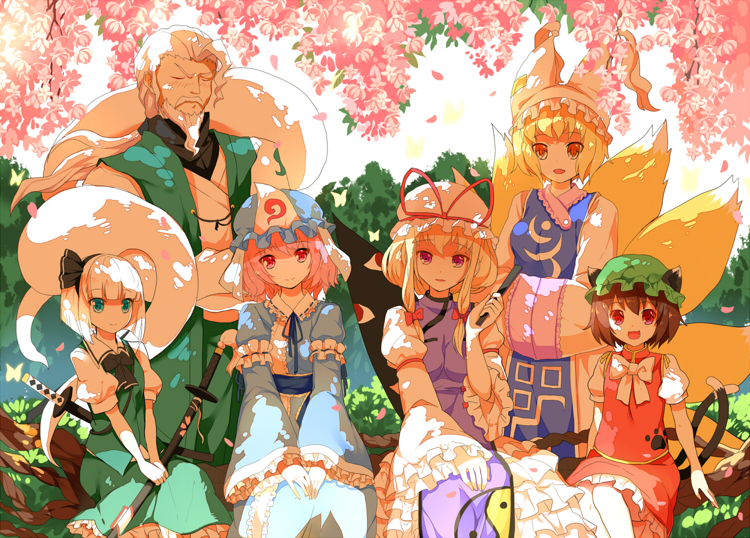
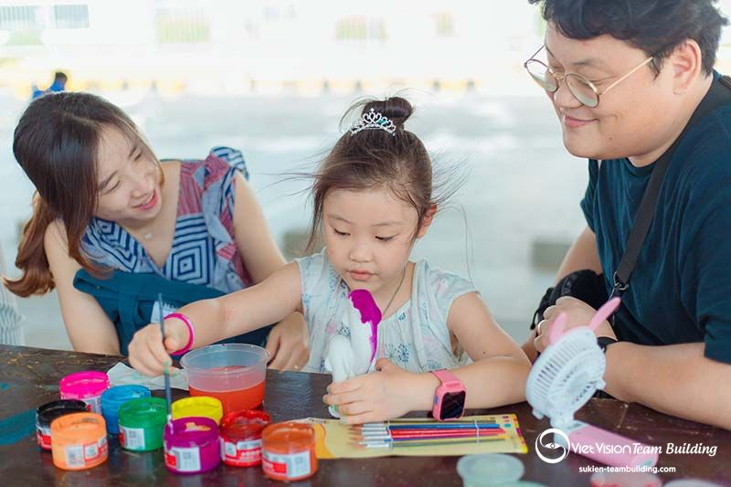
Take family picture
Have fun together

Slide 6
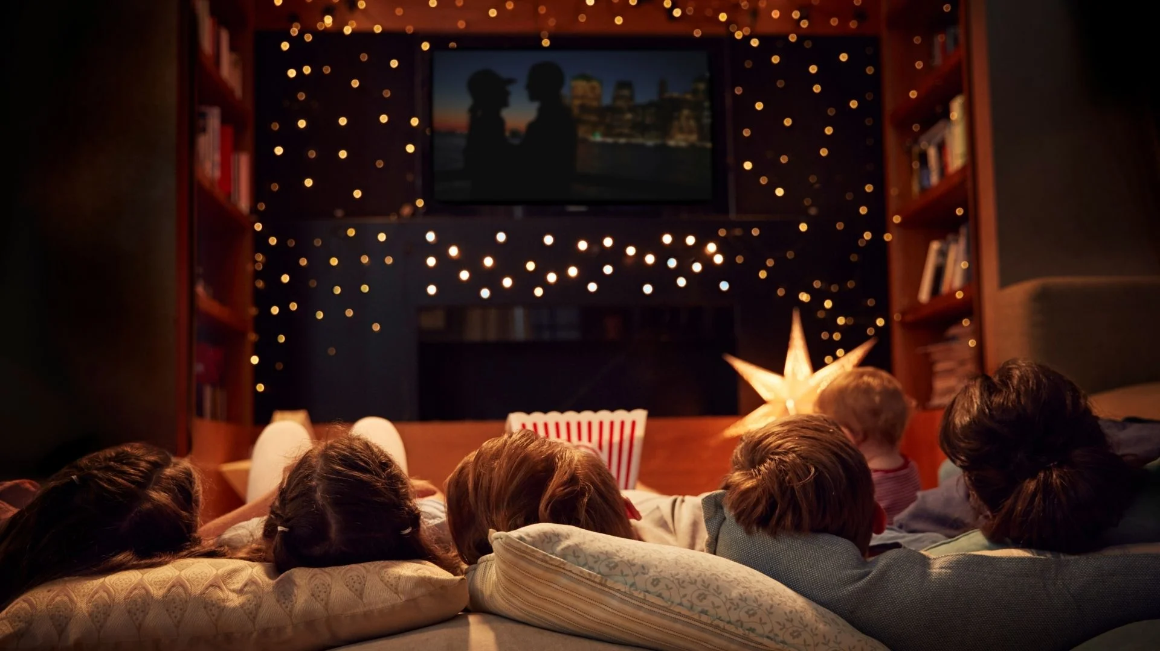
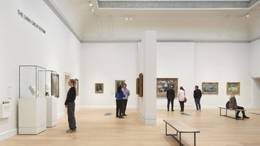
What people often do to celebrate Family Day in Canada?
Watch movies
Visit exhibitions

Slide 7
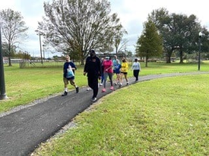
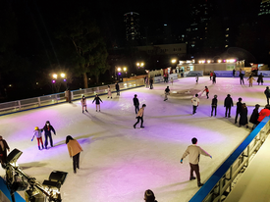
Walk in city parks
Go ice-skating

Slide 8

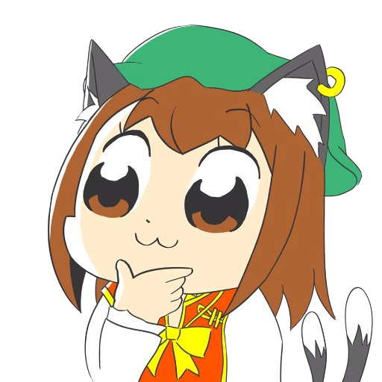

Can you suggest more ???

Slide 9

What do you think about the Family Day in Vietnam and Canada?

Slide 10

Ending the presentation
Thanks for listening

